Slide 1
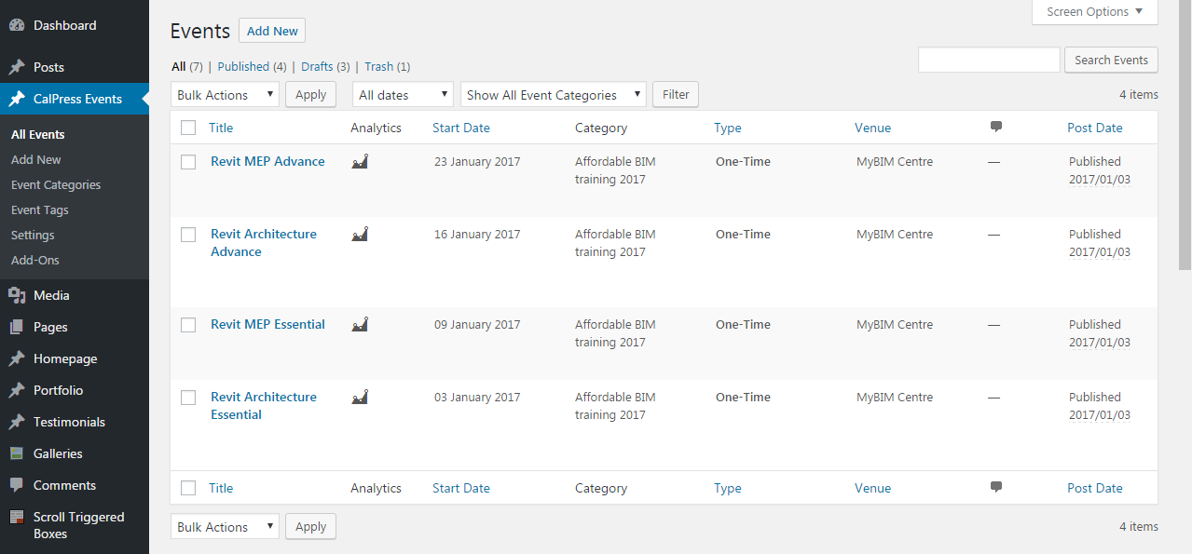
-go to CalPress Events
-Add New

Slide 2
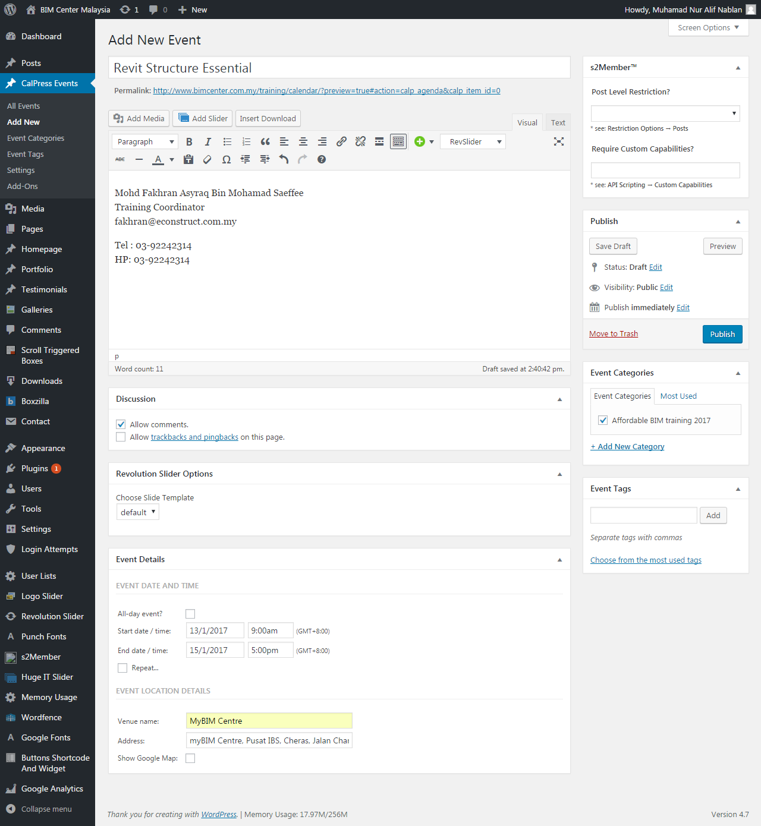
1
2
6
3
4
5

Slide 3
-link : http://www.bimcenter.com.my/training/calendar/
Location : mybimcenter.com > Training > Affordable BIM Training Schedule > Affordable BIM Training Schedule 2017

