Slide 1
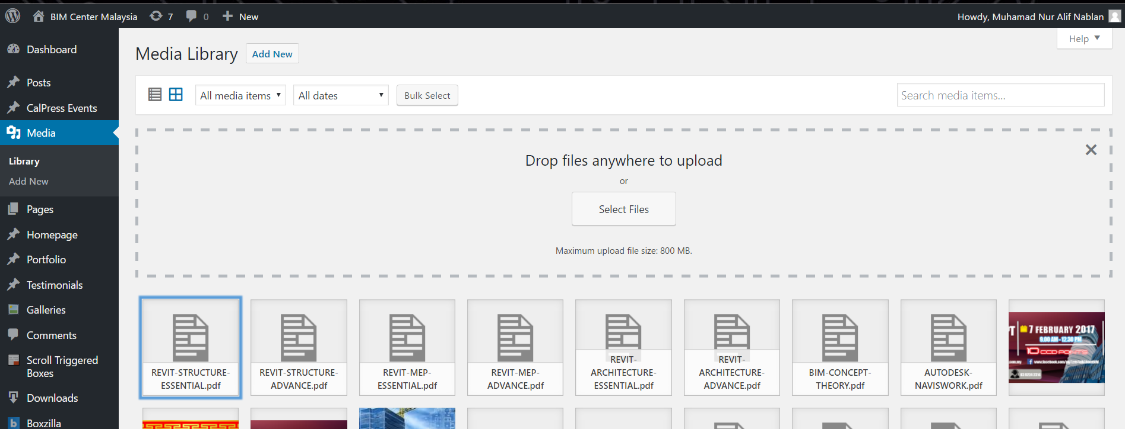
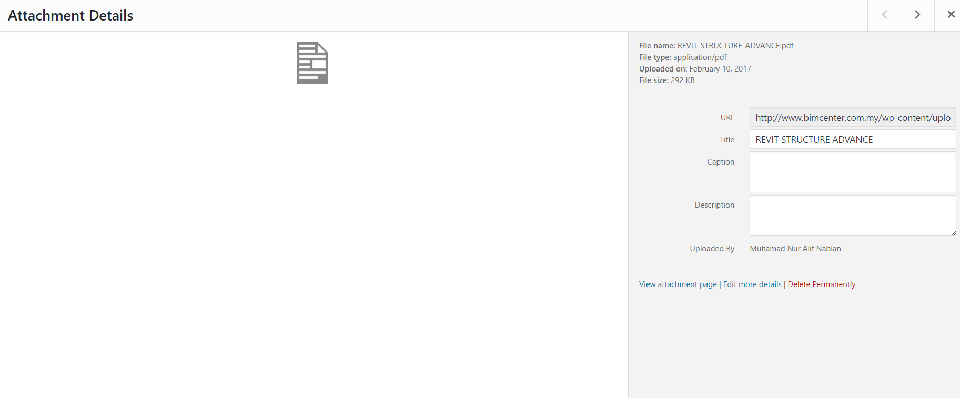
Manual add Course Outline
1.Upload file in Media > copy URL and text in notepad

Slide 2
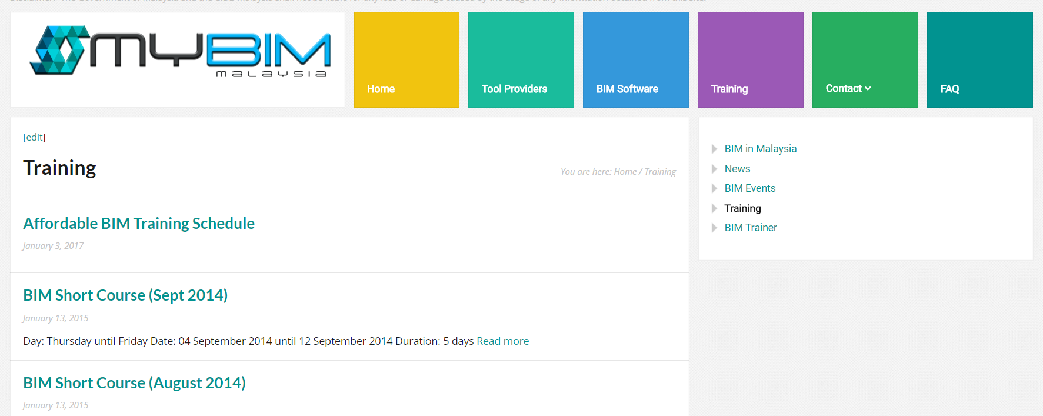
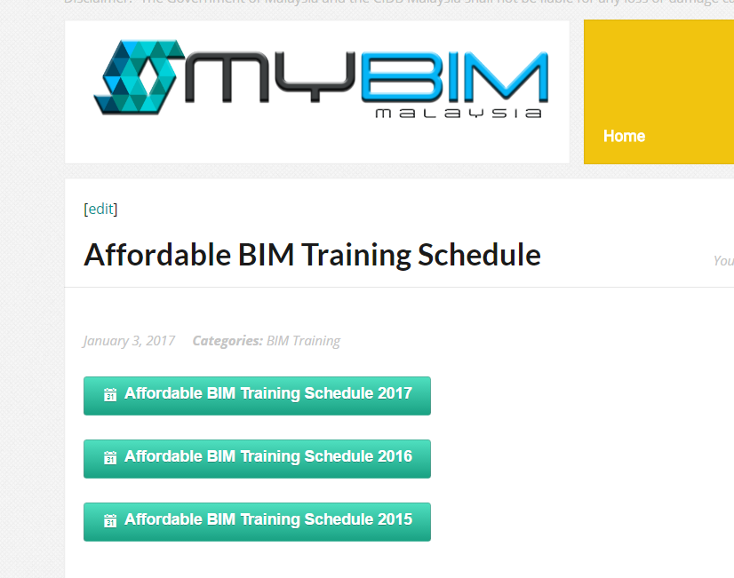
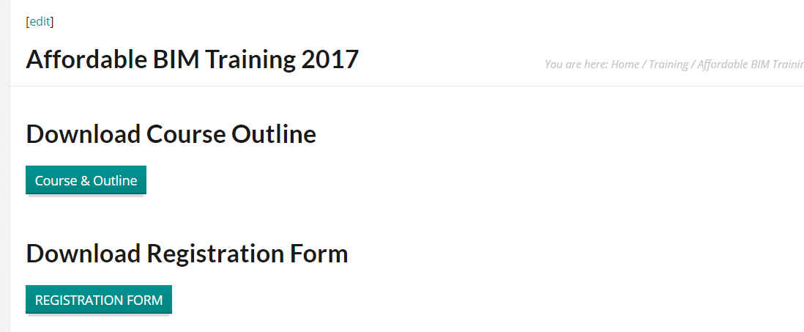
2.Click Training > Afforable BIM Training Schedule> Afforable BIM Training Schedule 2017>click course outline
1
2
3
4

Slide 3
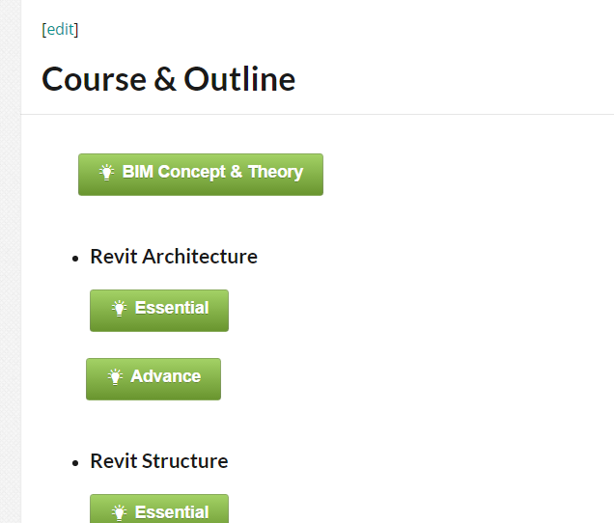
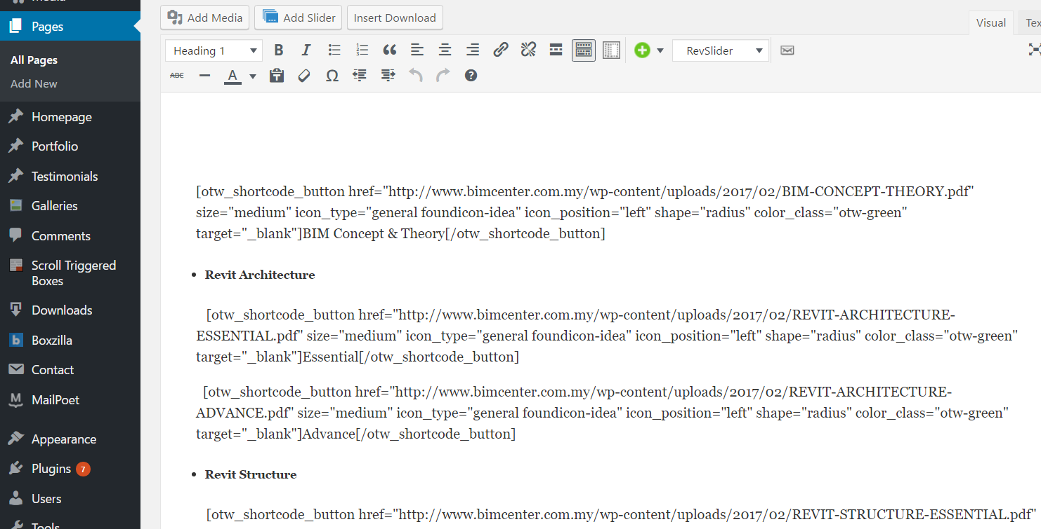
3. Click button Edit > Edit at “http” url and paste url pdf folder and edit title for that pdf folder > click button Update
1
2

