Slide 1
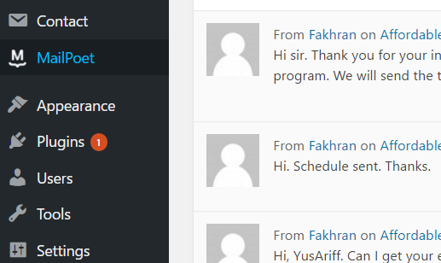
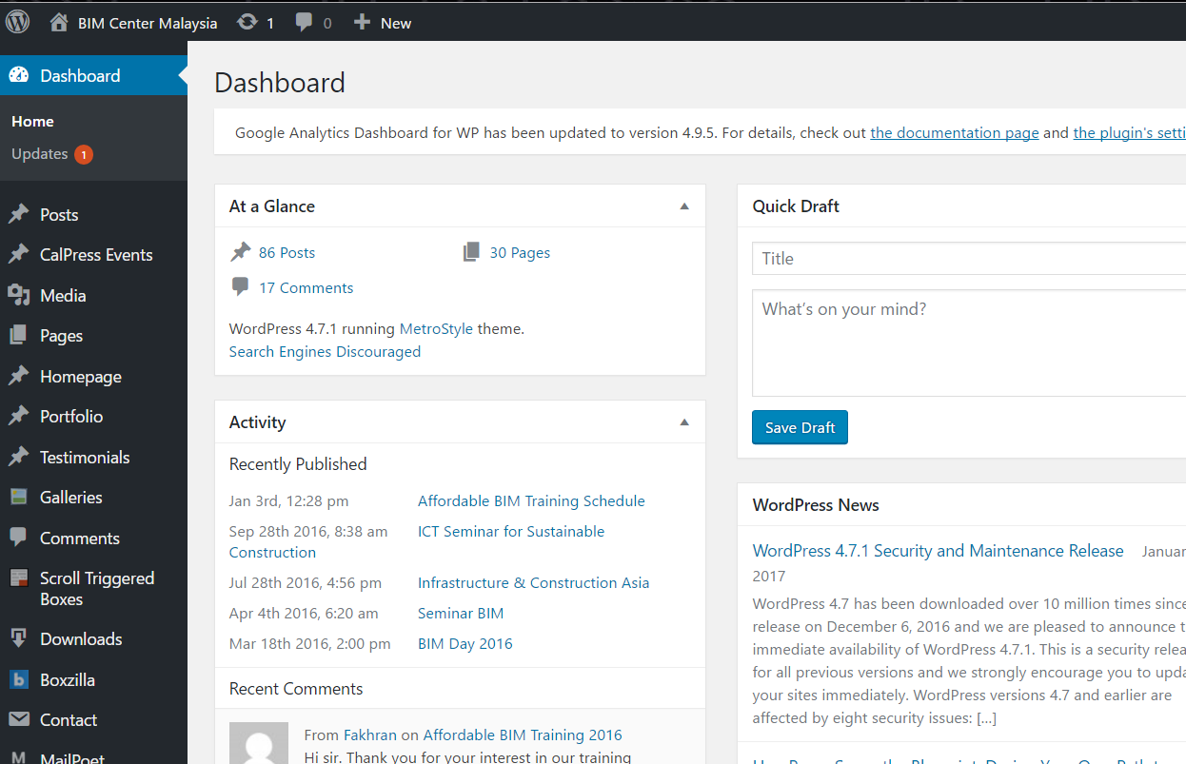
1.Cara2 nak edit content pada Footer myBIM Center Portal
Dashboard>Apperance>Customize
Footer

Slide 2
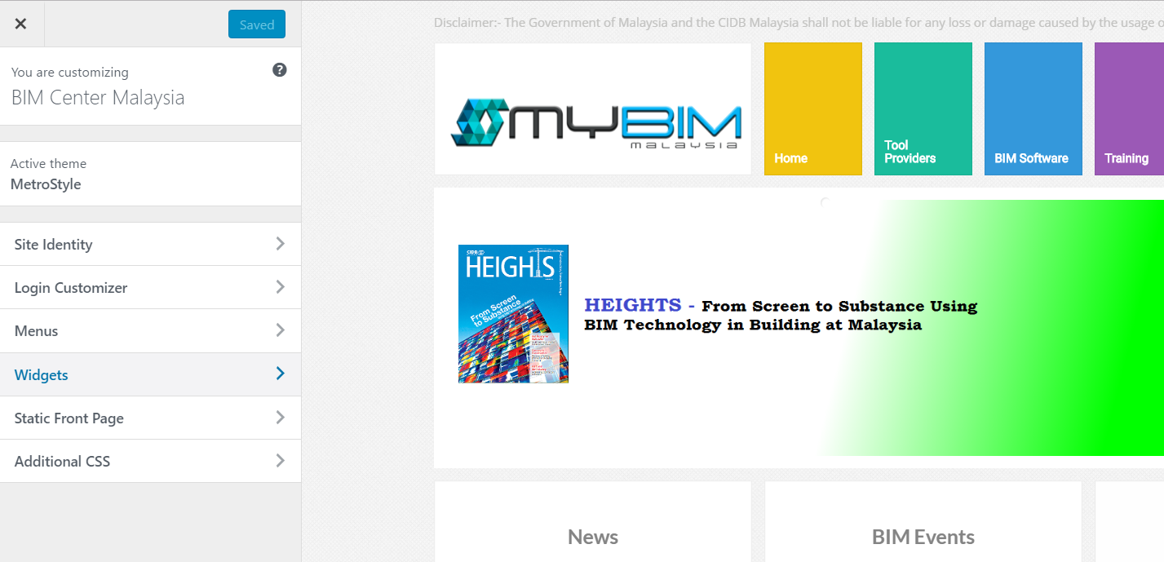
Widget>

Slide 3
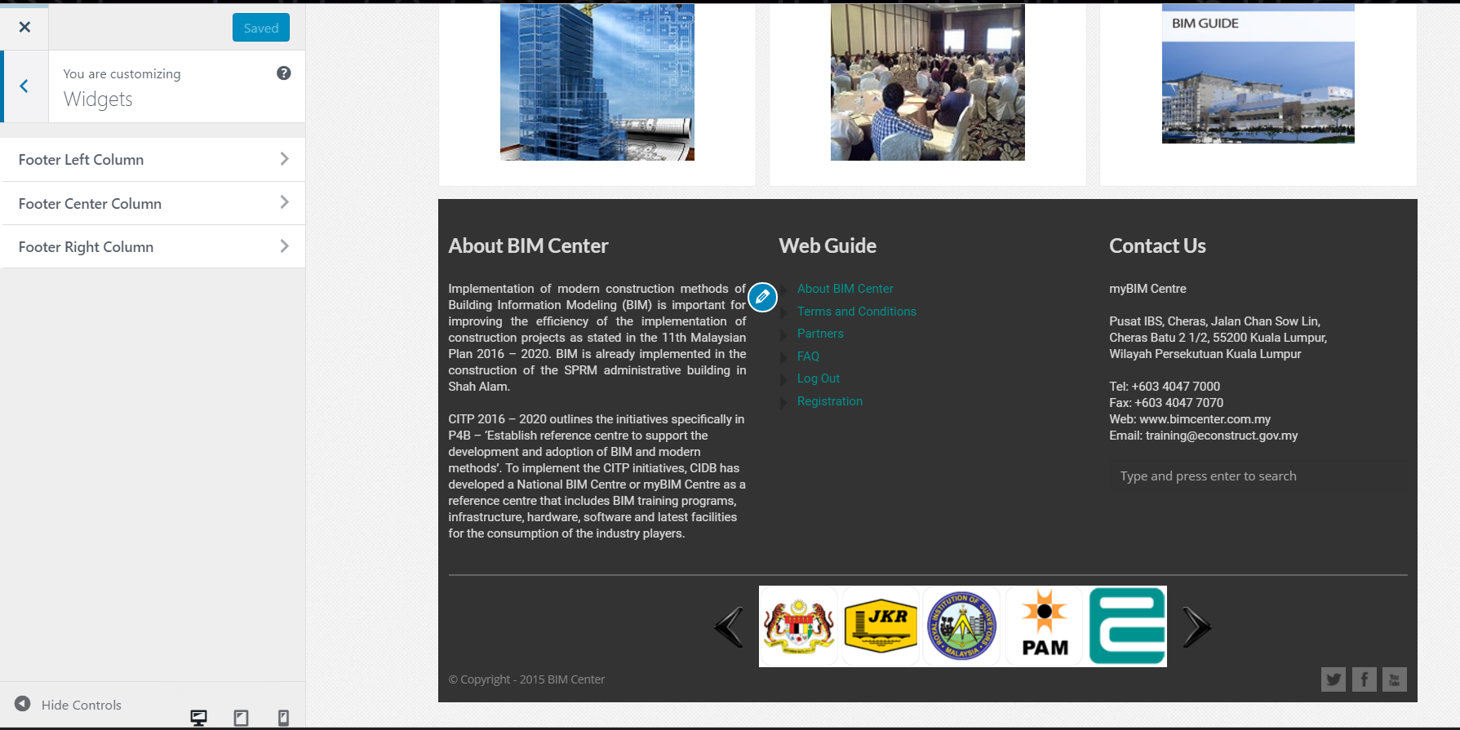
Footer Left Column : Utk edit bhgian left “ ABOUT BIM CENTER”
Footer Center Column : Utk edit bhgian tengah “WEB GUIDE”
Footer Right Column: Utk edit bhgian kanan “Contact Us”
And save

Slide 4
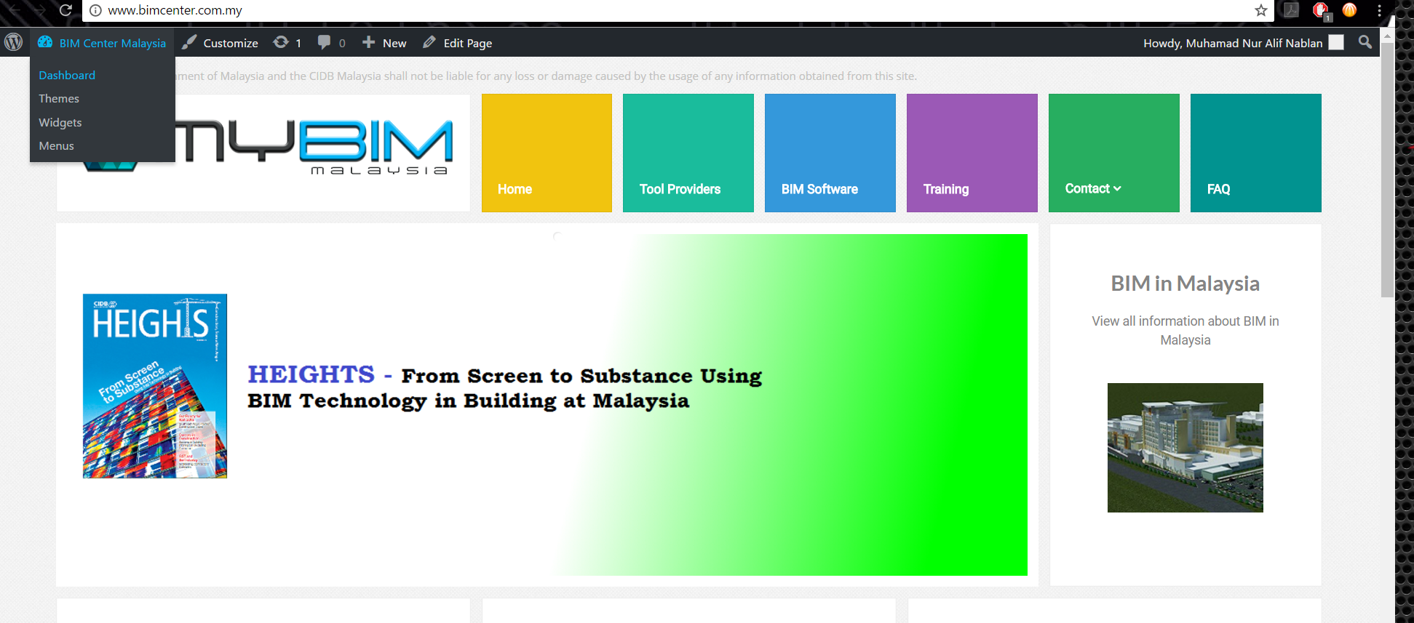
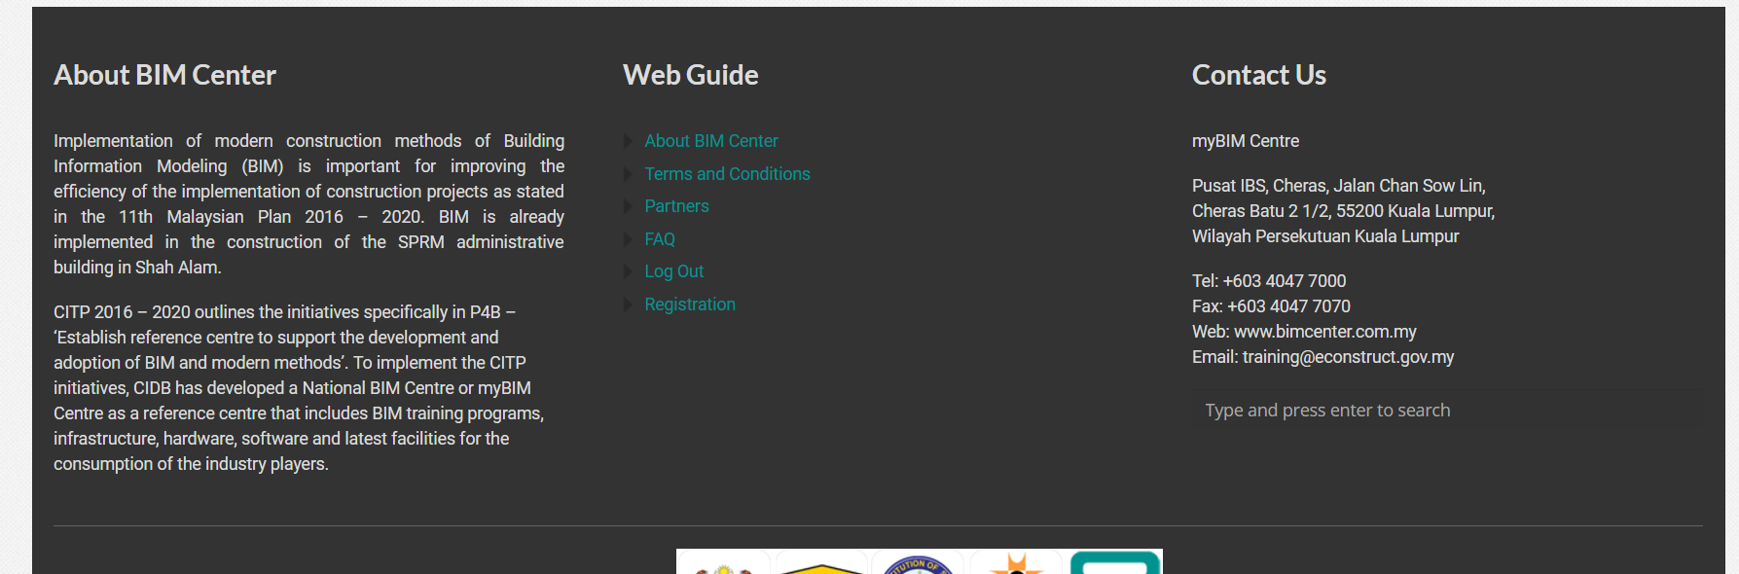
2.Cara2 nak edit information dekat page
Buka www.bimcenter.com.my>scroll down>click je mana2 content yg nk edit
Content Page

Slide 5
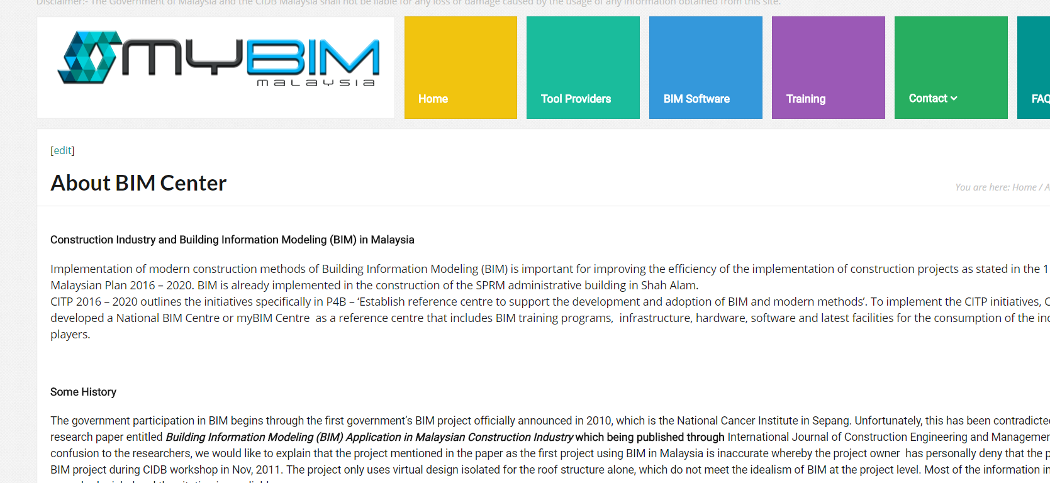
Click edit

Slide 6
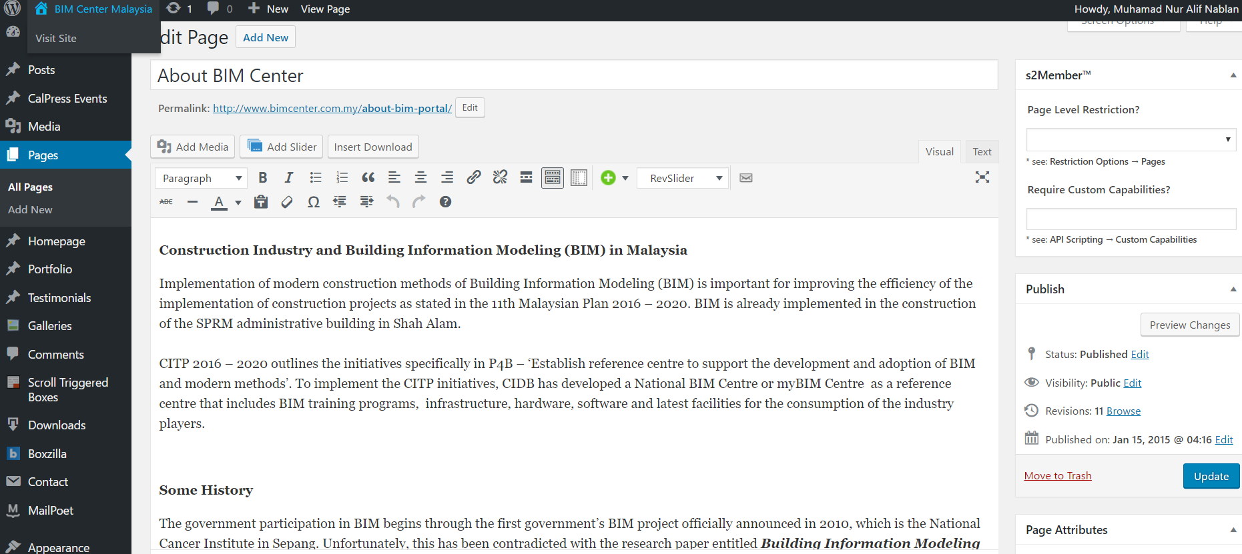
Edit yg mana perlu>Update done

